Slide 1



Hepatitis C Testing, Care and Treatment at Harm Reduction Centres in the European Union: a 28-Country Survey of Service Providers
Prof Jeffrey V Lazarus [Jeffrey.Lazarus@regionh.dk]
CHIP, Rigshospitalet, University of Copenhagen, WHO Collaborating Centre on HIV and Viral Hepatitis
@JVLazarus

Slide 2
Funding statement
This research is part of the joint action ‘677085 / HA-REACT,’ which has received funding from the European Union’s Health Programme (2014-2020) with additional support from the Correlation Network.

Slide 3
Introduction
WHO, UNAIDS, UNODC and other international organisations all recommend that a comprehensive package of harm reduction services be available to people who inject drugs (PWID).
The continuum of care is a theoretical tool popularised in the field of HIV:
  Patients must be diagnosed and informed of their infections (testing);
  They must be able to receive appropriate supervision and services during the course of their infection (linkage to care); and
  They should be given recommended HCV therapy regimens to achieve sustained virologic response (treatment).
No previous study has comprehensively assessed health systems enablers and barriers affecting the ability of PWID to move through the HCV care cascade – from testing, to care, to full treatment – within the European Union specifically.
This study sought to inform the European Joint Action on HIV and Co-infection Prevention and Harm Reduction (HA-REACT)’s ongoing work by assessing the knowledge of non-governmental harm reduction providers in the EU on HCV testing, care and treatment.
#HAREACT @JVLazarus

Slide 4
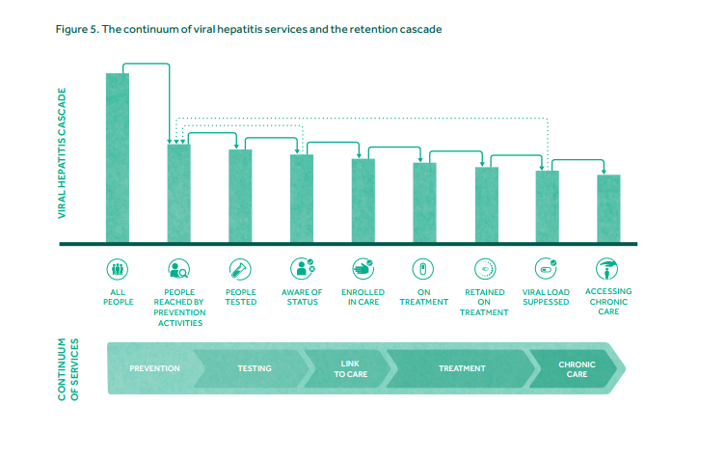
The continuum of viral hepatitis services and the retention cascade
Source: Grebely J, Bruggmann P, Treloar C, Byrne J, Rhodes T, Dore GJ; International Network for Hepatitis in Substance Users. Expanding access to prevention, care and treatment for hepatitis C virus infection among people who inject drugs. Int J Drug Policy. 2015 Oct;26(10):893-8.
#HAREACT @JVLazarus
Notes:
Grebely J, Bruggmann P, Treloar C, Byrne J, Rhodes T, Dore GJ; International Network for Hepatitis in Substance Users. Expanding access to prevention, care and treatment for hepatitis C virus infection among people who inject drugs. Int J Drug Policy. 2015 Oct;26(10):893-8.

Slide 5
Methods
Participants were purposively selected. The survey was sent to organisations that were part of the Correlation Network (co-founded by the European Commission), and which provides or organises harm reduction services in all 28 Member States of the European Union
The survey was open during a 7-week period: 29 March 2017 and closed on 17 May 2017.
Descriptive findings are presented by the country of the respondent.
#HAREACT @JVLazarus

Slide 6
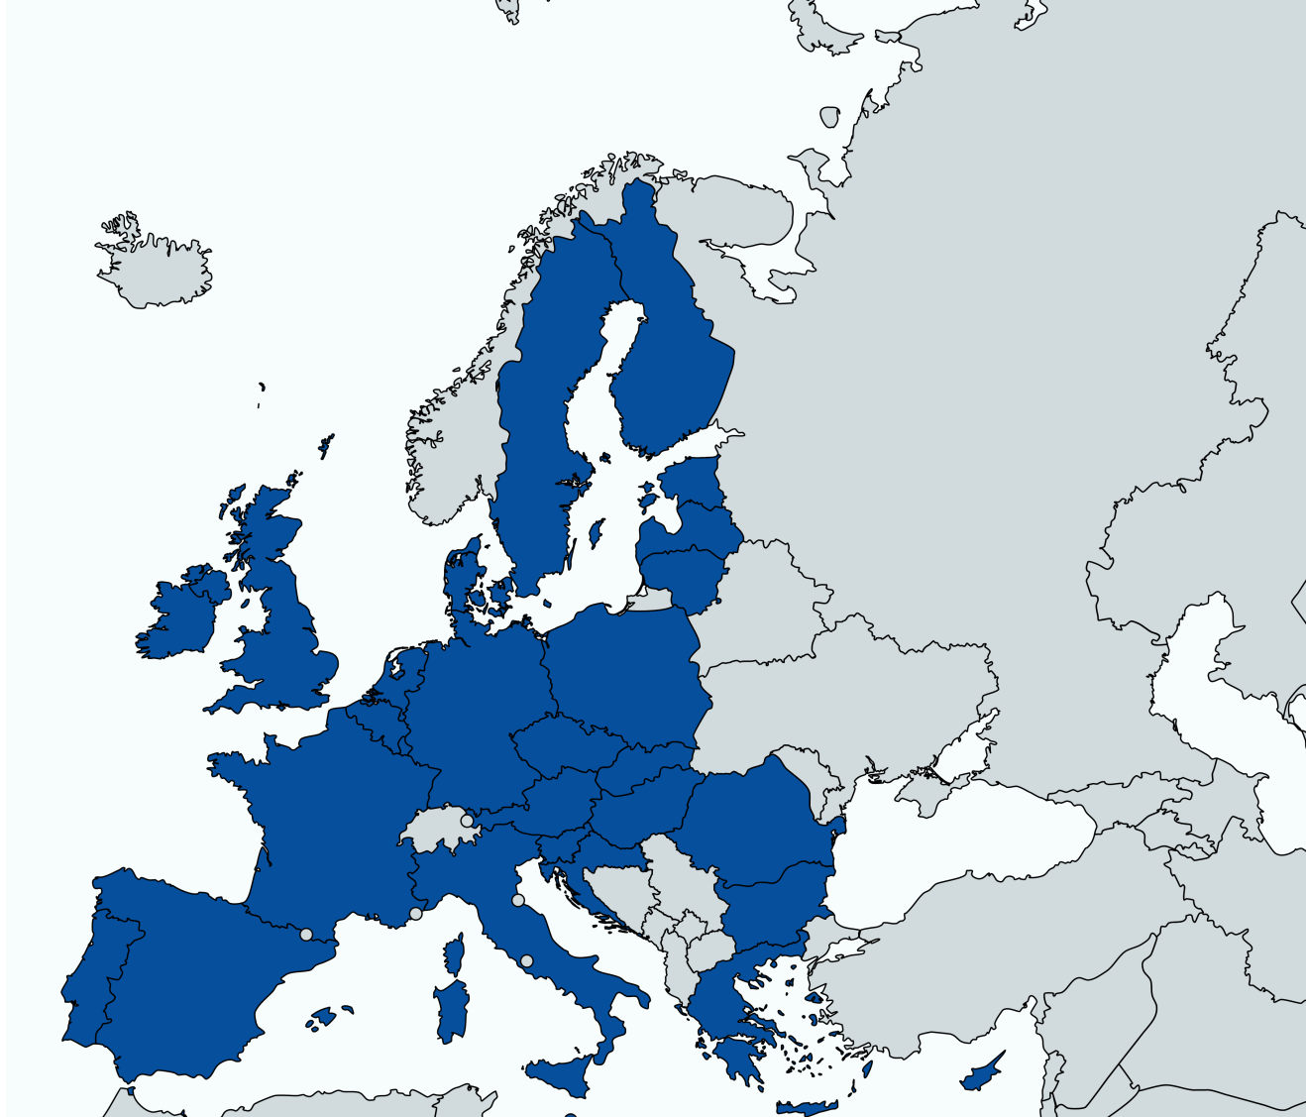
Results
Countries responded
(All EU Member States)
N=30*
* The United Kingdom is represented by responses from England and Scotland, and Spain is represented by responses from Catalonia and the Basque Country. These autonomous communities are reported separately from one another, as they are known to have differing healthcare systems. This study does not give a comprehensive overview of the complexities of all healthcare systems in a given country.
#HAREACT @JVLazarus

Slide 7
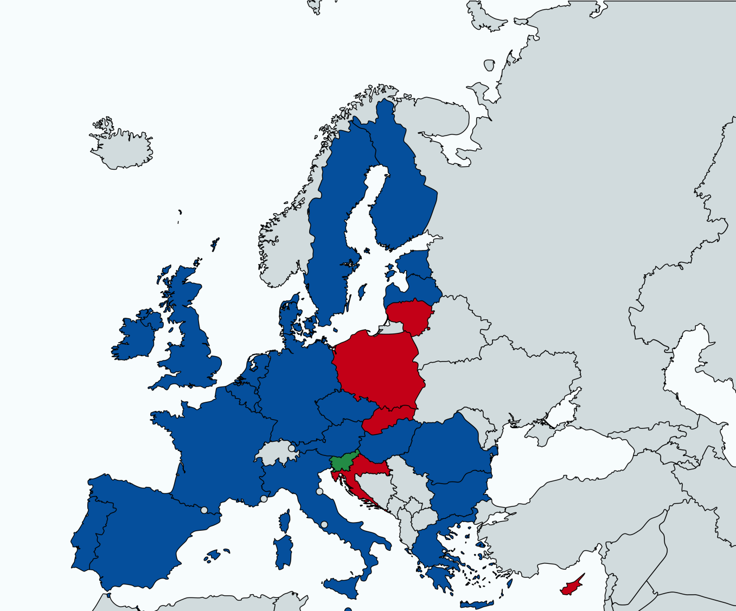
Are hepatitis C tests offered by any harm reduction services in your country?
Testing available (23/30)
Testing not available (5/30)
Respondent did not know (2/30)
#HAREACT @JVLazarus
Notes:
Slovenia and Basque Country said they did not know.
Begs the questions what kind of test and is there linkage to care.

Slide 8

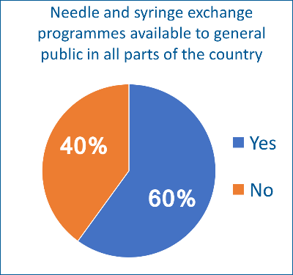
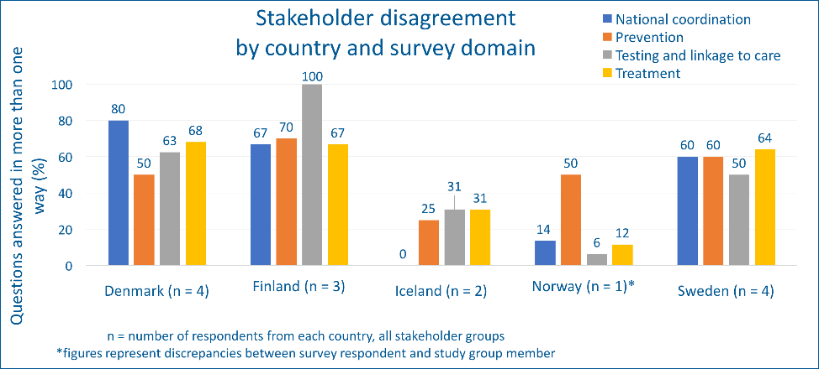
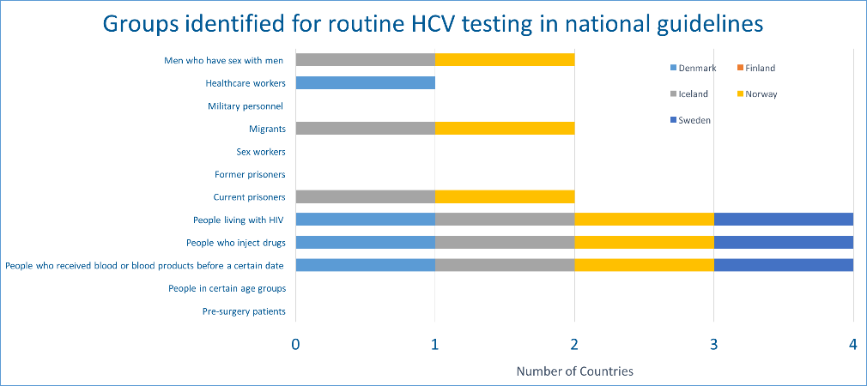
Results
Widespread disagreement was reported between stakeholders respondents
Results showed gaps in policies for harm reduction both within and outside prisons
Strategies/policies for responding to hepatitis C still lacking in the Nordic countries
Need for scaling up guidelines for prevention, testing, treatment, and goals for elimination
Source: Safreed-Harmon et al. PLOS One 2018
#HAREACT @JVLazarus
Notes:
Flying blind as even in small well resourced countries, key stakeholders do not agree on what the key policies in place are.
Need to measure policy change

Slide 9
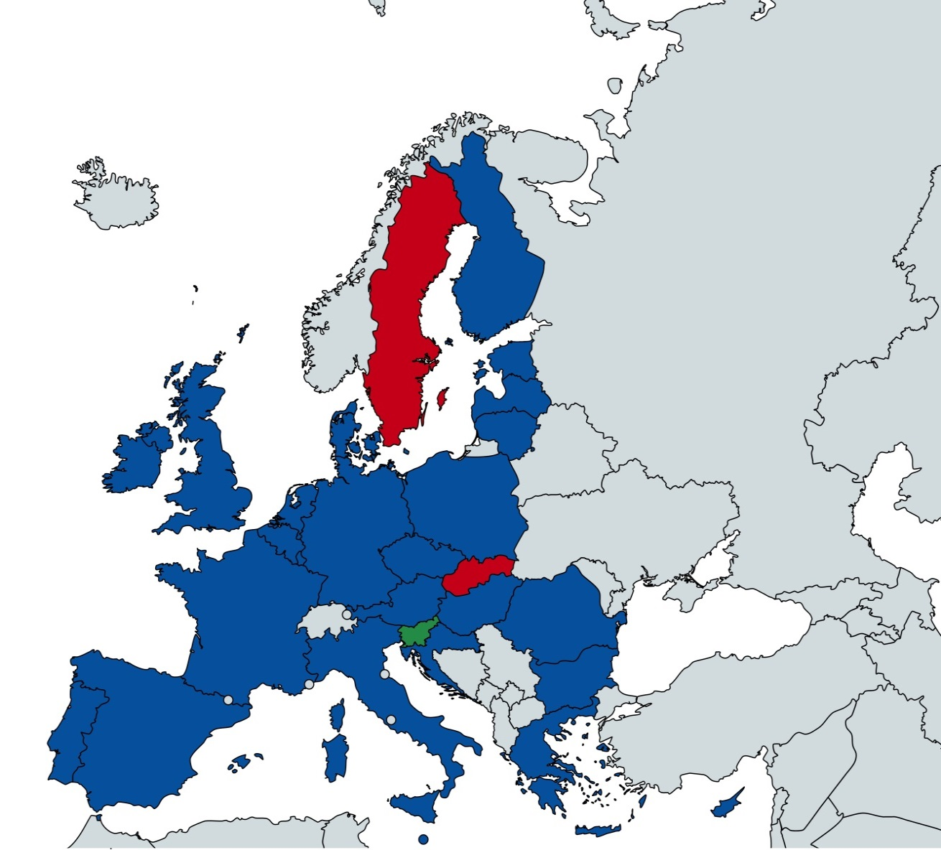
Are organisations that provide services to PWID in your country involved in managing any aspect of hepatitis C care?
Services manage care (26/30)
Services do not manage care (2/30)
Respondent did not know (2/30)
#HAREACT @JVLazarus

Slide 10
Can addiction specialists in your country prescribe HCV therapy?
20 of 30 respondents said no –
8 of 30 respondents
said yes –
Austria
Basque Country
Belgium
Bulgaria
Catalonia
Croatia
Estonia
Finland
France
Greece
Hungary
Italy
Lithuania
Malta
Netherlands
Poland
Portugal
Scotland
Slovakia
Sweden
Cyprus
Czech Republic
Denmark
England
Germany
Luxembourg
Romania
Slovenia
2 of 30 respondents did not know –
Ireland
Latvia
#HAREACT @JVLazarus
Notes:
In some countries reluctance (eg Germany)
Or
Not widespread: Denmark

Slide 11

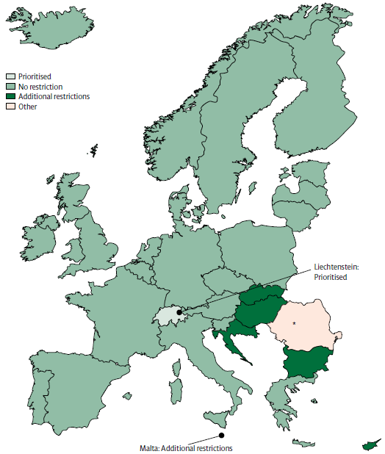
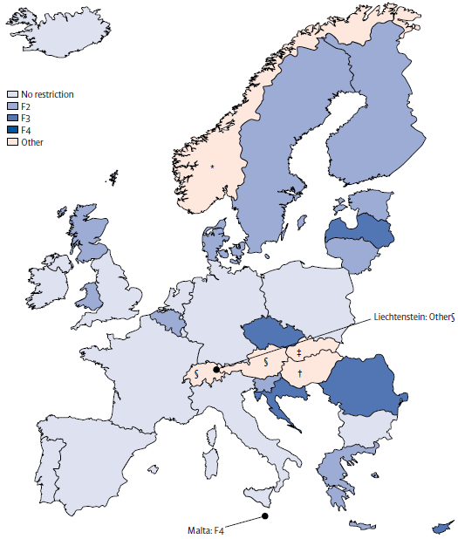
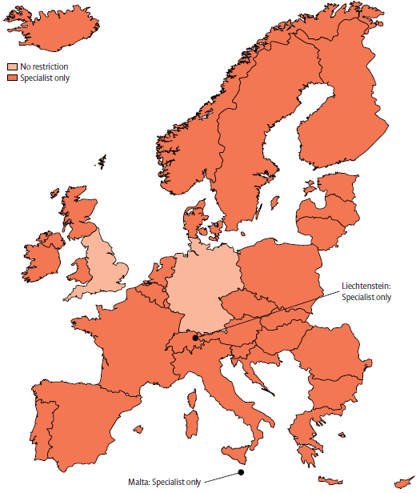
Restrictions are testing and treatment barriers
46% >F2 (advanced disease)
17% drug/alcohol use
94% specialist prescribing
Source: Marshall AD et al. Restrictions for reimbursement of interferon-free direct acting antiviral therapies for HCV infection in Europe. Lancet GastroHep, 2017.
#HAREACT @JVLazarus
Notes:
An increasing number of countries have no restrictions.
REFER TO THE BCG TALK ABOUT TO FOLLOW.
*One country, Malta, (3%, n=1) required evidence of F4.
Lack of transparency, huge disparity in prices…
Prioritised meant that people with drug or alcohol use dependencies had fewer restrictions for
access to reimbursed DAAs than individuals without drug or alcohol use dependencies. No restrictions meant
that people with drug or alcohol use dependencies could receive reimbursed DAAs; for example, a person who
currently injected drugs (or had a history of injection use) could be offered DAAs. Additional restrictions
meant that individuals with drug or alcohol use dependencies needed to fulfil further criteria before
being eligible for DAA reimbursement.

Slide 12
Source: Marshall AD, et al. JHEP In press 2018.
#HAREACT @JVLazarus

Slide 13
Conclusions: What can we do?
The HA-REACT survey findings are indicative and do not pretend to present the current policy in a country. They reflect the understanding of members of the leading network of non-governmental harm reduction organisations in the European Union.
That not all EU countries have HCV testing available at harm reduction services and that addiction specialists are only able to prescribe HCV treatment in a handful of EU member states indicate major missed opportunities.
Practice and policy should be reviewed at the national and sub-national levels so that it can be changed to increase HCV testing and prescribing in addiction/harm reduction centres, in line with the UN comprehensive package’s recommendation for PWID: “…diagnosis and treatment of viral hepatitis”.
#HAREACT @JVLazarus
Notes:
We are at the EMCDDA who collects data from Reitox national focal points.
WHO, UNODC, UNAIDS technical guide for countries to set targets for universal access to HIV
prevention, treatment and care for injecting drug users. 2009

Slide 14
Acknowledgements
Co-authors: Bromberg DJ, Ocampo D, Schatz E, Wawer I, Wysocki P, Safreed-Harmon K
All survey participants and in particular the Correlation Network for dissemination the survey.
More at: www.hareact.eu/en
#HAREACT
#HAREACT @JVLazarus

